Slide 1

NFL Combine Research Analysis
By Matthew Lane

Slide 2

Contents
1. Title Slide
2. Table of Contents
3. Brief overlook of our dataset
4. Research questions we’ll be attempting to answer
5. Hypotheses we will be testing
6. How they can be utilized
7-9. Dive into the results of our three tests
10. Summary
11. Suggestions for next steps
12. Reference and Q&A

Slide 3

Our Dataset
Dataset being used contains information on players in the 2022 NFL combine. For reference, the original dataset is here.
There are 316 records across 10 fields, but we will be focusing only on the fields used in our analysis, which are as follows:
Player weight in lbs.
Player hand size
40-yard dash speed in seconds
Vertical leap in inches
Notes:
A dataset I scraped myself from the NFL combine website

Slide 4

Research Questions
There is three questions that will be addressed in this analysis.
Is there a relationship between players weight and how high they can go on a vertical leap.
Can a player's height be a factor in their hand size?
Do heavier players tend to have a slower 40-yard dash time?

Slide 5

The Hypotheses
Hypothesis #1: Despite the exceptional athleticism of participants in the NFL Combine, there will still be a relationship between weight and how high they can vertically jump.
Hypothesis #2: That there is a correlation between taller players and their hand size.
Hypothesis #3: Heavier players will typically be slower than lighter ones.
Notes:
We are testing with the nulls as the assumed result, as in there is no relationship

Slide 6
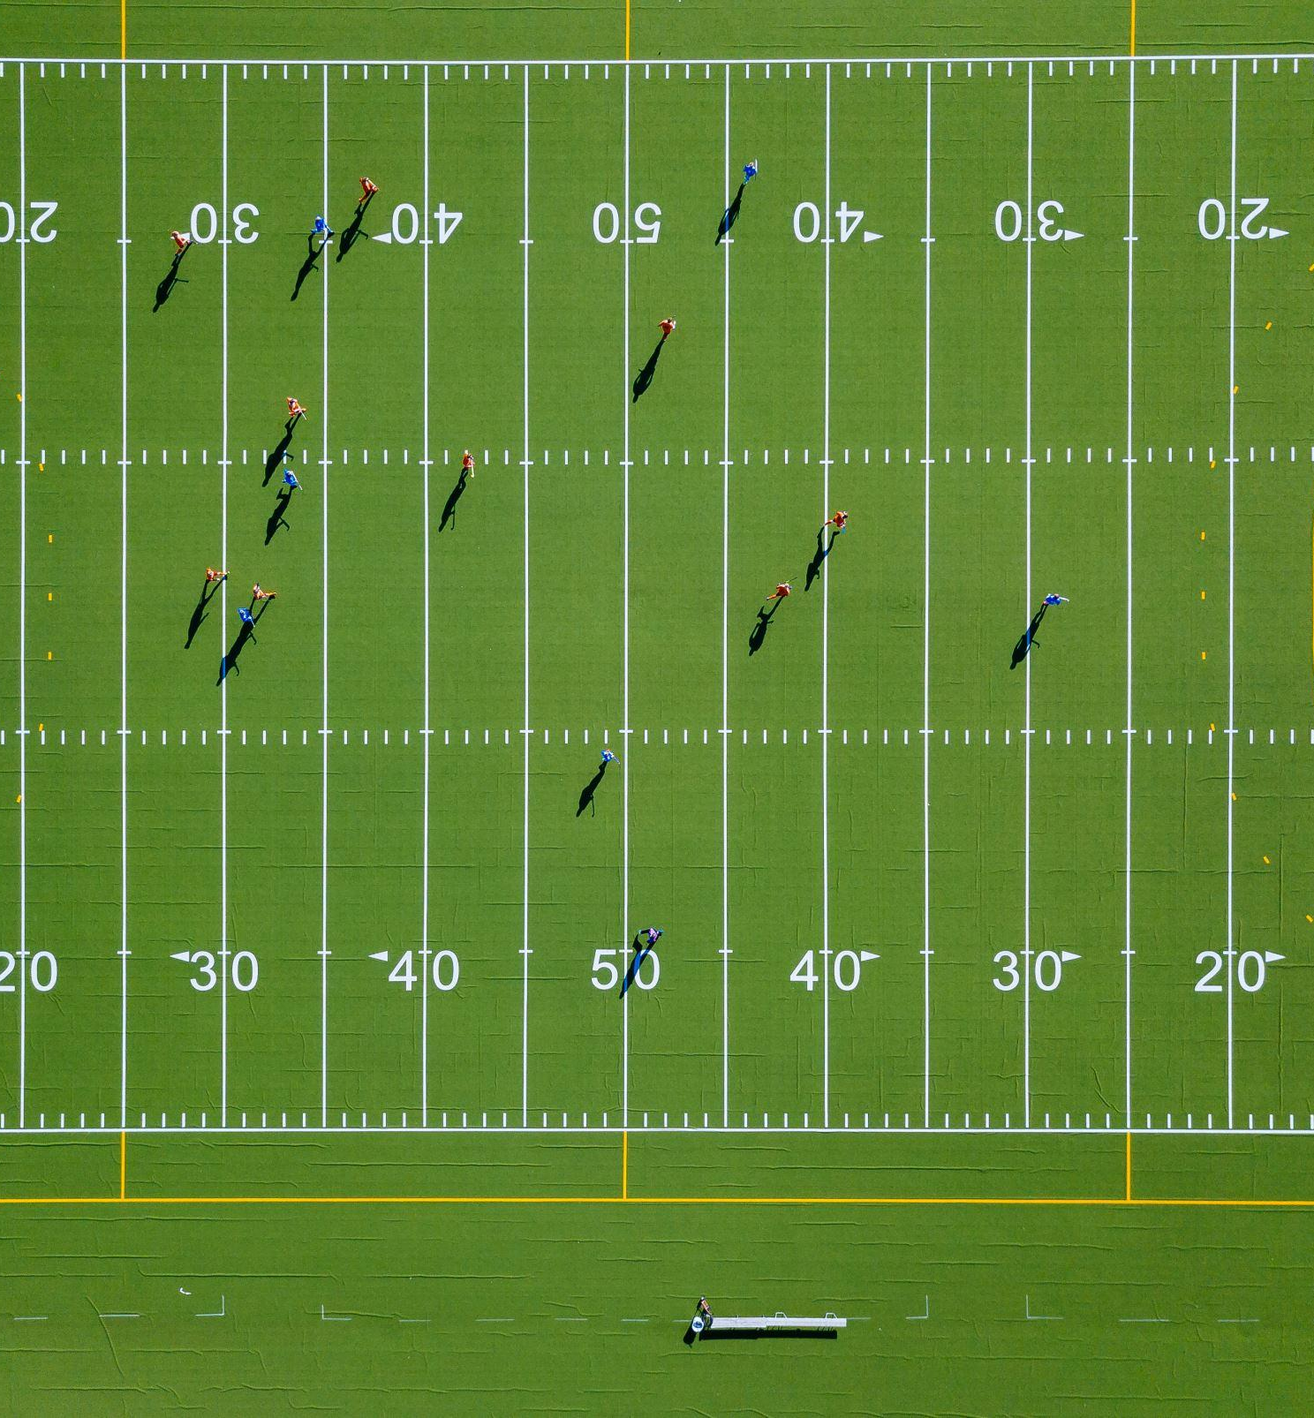
How can we utilize these findings?
The results of our testing can be useful for both research and to help streamline recruitment.
Examples for recruitment could be:
If you are looking for a faster player for your team, you may want to look at factors like weight if you do not have a dash time.
Perhaps consider taller players as receivers.
Also, helpful to be aware that larger defensive players may not have as much verticality for pass protection.

Slide 7
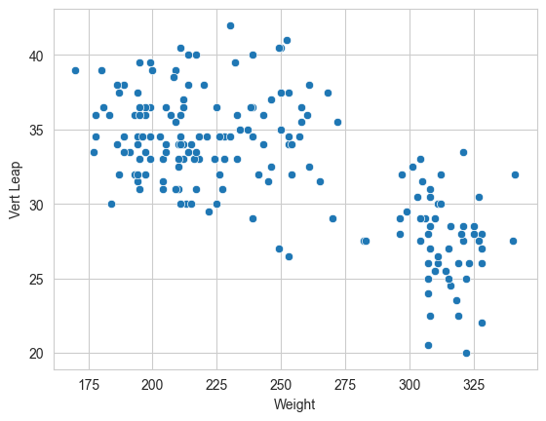
The Analysis - Vert Leap & Weight
Inches
With a probability value that a point would have occurred under the null hypothesis well into scientific notation we can reject the null hypothesis. Also, the results of our Pearson R test show that the correlation is in fact a negative, rejecting the null and confirming our hypothesis heavier players do have a lesser vertical jump.
lbs
Notes:
p- value: 1.8248737991637125e-26, probability in the quadrillions below 0.0
Correlation Coefficient: -0.6761075605565661

Slide 8
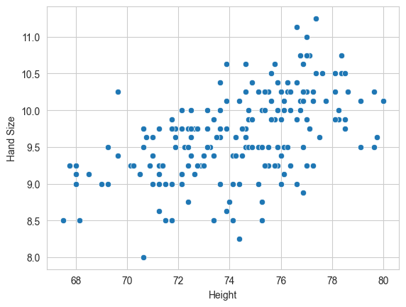
The Analysis - Hand Size & Height
Inches
With another small p-value we can again reject the null hypothesis that no relationship exists between height and hand size and the positive upward slope of our data demonstrates that typically a taller player will have a larger hand size.
Inches
Notes:
correlation coefficient: 0.5221767885051699,
p- value: 1.5273200664362415e-14

Slide 9
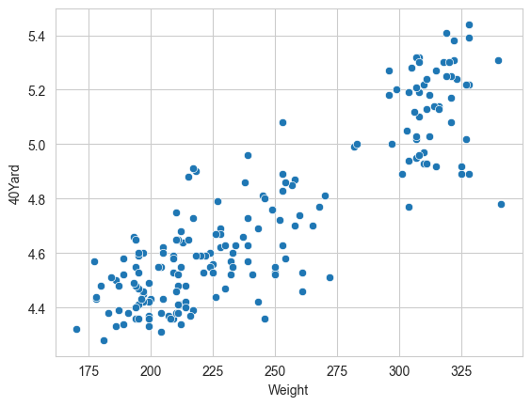
The Analysis - 40 Yard & Weight
Seconds
This test shows our strongest relationship tested in the data, disproving the null hypothesis that weight is not a factor in a players 40-yard dash times and that heavier athletes tend to take longer to complete this exercise.
lbs
Notes:
correlation coefficient: 0.8757587924601592,
p- value: 9.901091553913835e-61

Slide 10

Summary
All 3 of our hypotheses tested were confirmed;
Firstly, heavier players do have less verticality therefore may not be a team's best option for pass defense.
Secondly, taller players have larger hands and may have an advantage as a receiver.
Finally, when looking for a player with speed, the heavier they are the slower they commonly are.

Slide 11

Next Steps
Other factors that may be interesting to test for are things like if it is a factor whether the player was offensive or defensive in college and explore through t-testing how that plays a factor into performance indicators.

Slide 12

Questions?
For reference:
The project proposal is here .
The Colab Notebook is here.

